Slide 1





DeepCaps : Going Deeper with Capsule Networks
Jathushan Rajasegaran Vinoj Jayasundara Sandaru Jayasekara
Hirunima Jayasekara Suranga Seneviratne Ranga Rodrigo
June 20 2019
Notes:
Hi everyone, I am Jathushan from university of Moratuwa. In this talk I am going to introduce our work on deep capsule neural networks.

Slide 2
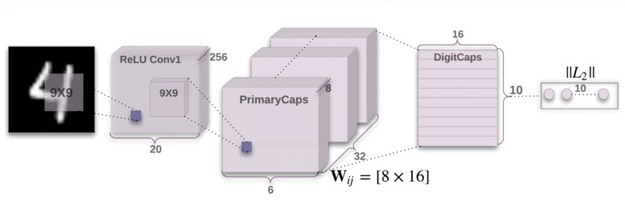
Capsule Neural Networks
[1] S. Sabour, N. Frosst, and G. E. Hinton, “Dynamic routing between capsules,” in NIPS, Long Beach, CA, 2017
Notes:
Capsule network is fairly a new concept and it promises new directions for deep learning.
Capsule networks achieve Equi-variance in the network by introducing dynamic routing between low level and high level capsules.

Slide 3
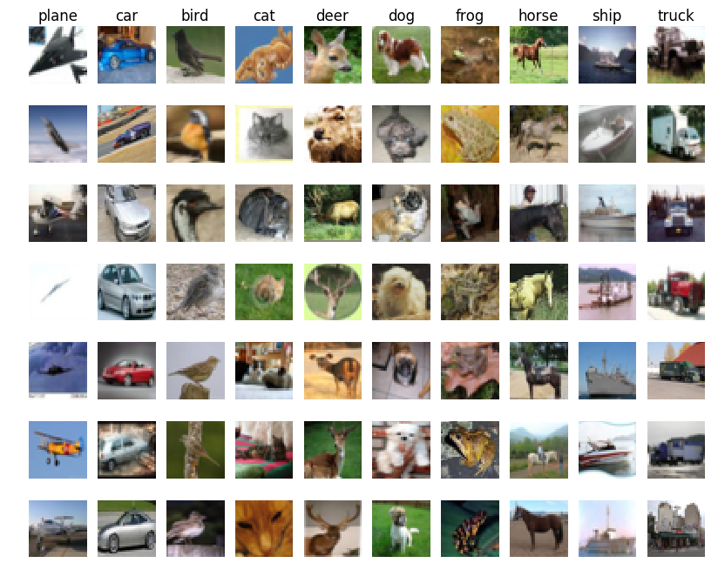

Motivation
MNIST - low level
feature representation
CIFAR10 - high level
feature representation
Achieves SOTA on MNIST
(99.75%) [1]
Only 89.6% on CIFAR10
With 7-ensembles.
[1] S. Sabour, N. Frosst, and G. E. Hinton, “Dynamic routing between capsules,” in NIPS, Long Beach, CA, 2017
Notes:
Even though Capsule networks achieve state-of-the-art performances with less complex data, for example MNIST,
their performance on more complex data is low in comparison to the state of the art CNNs.

Slide 4
Goals
1. High level understanding with capsules
2. Joint representation of classes with instantiation
parameters
3. Computationally efficient network
Notes:
So, our main goals is to develop
1. a capsule based neural network, with higher level understanding
2. Also we want to create a joint representation of instantiation parameters
3. and a computationally efficient network

Slide 5

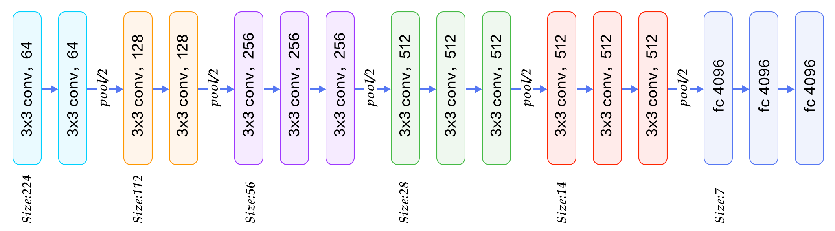
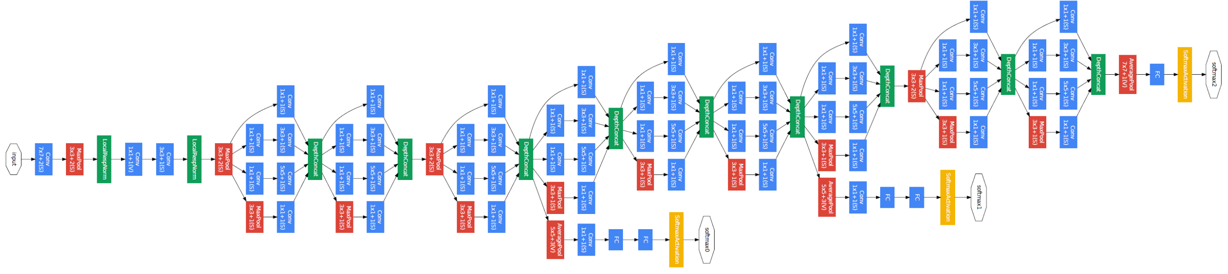
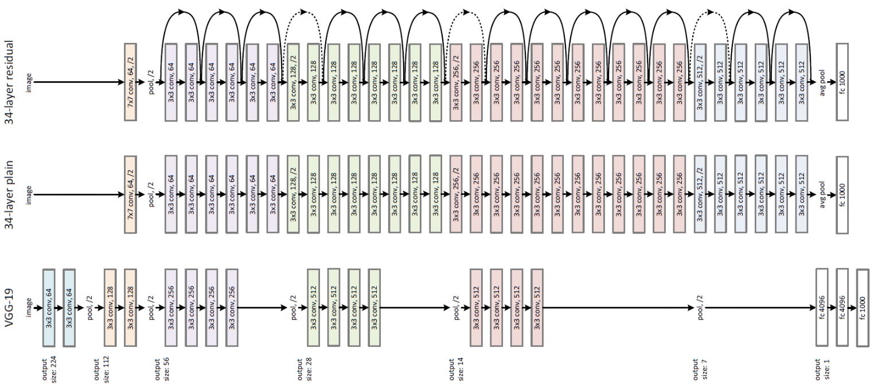
Inspired by Conventional CNNs
AlexNet [1]
VGG Net [2]
GoogLeNet [3]
ResNet [4]
[1] A. Krizhevsky, I. Sutskever, and G. Hinton. Imagenet classificationwith deep convolutional neural networks. In NIPS, 2012
[2] S. Ren, K. He, R. Girshick, and J. Sun. Faster R-CNN: Towardsreal-time object detection with region proposal networks. In NIPS,2015
[3] C. Szegedy, W. Liu, Y. Jia, P. Sermanet, S. Reed, D. Anguelov, D. Er-han, V. Vanhoucke, and A. Rabinovich. Going deeper with convolutions. In CVPR, 2015
[4] K. He, X. Zhang, and S. Ren, “Deep residual learning for image recognition,” in CVPR, 2016
Notes:
Our network is inspired by the developments over the past decade in CNNs.
In general, CNN performance increases when going deeper into the network architecture.
Thus, we need to go deeper with the capsule networks to fully realize its potential.

Slide 6
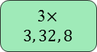
Proposed Deep Capsule Networks
3$×3, 32, 8$
ConvCaps Layer
CapsCell
Notes:
So how we can do thus?
Our proposed network is based on the ConvCaps layer, which is used to build a modular architecture of capscell.
A CapsCell contains 4 convcaps layers and a bypass skip connection with element wise addition.
By stacking 4 of the capscells we build our deepcaps network architecture.

Slide 7
ConvCaps layer
Notes:
We use a 3D convolutional kernel to apply a low-level to high-level transformation.
by utilizing kernel dimension same as number of atoms in a capsule,
We generate a layer for higher level capsule tensor.

Slide 8
ConvCaps layer
Notes:
Then by using multiple kernels we can produce higher level capsules tensor.

Slide 9
ConvCaps layer
Notes:
Then by using multiple kernels we can produce higher level capsules tensor.

Slide 10
ConvCaps layer
Notes:
Then by using multiple kernels we can produce higher level capsules tensor.

Slide 11
ConvCaps layer

Slide 12
ConvCaps layer

Slide 13
ConvCaps layer

Slide 14
ConvCaps layer
Notes:
Sharing the same kernels across all the input capsule tensors,
helps to reduce the number of parameters required for the network.

Slide 15
ConvCaps layer
Notes:
Sharing the same kernels across all the input capsule tensors,
helps to reduce the number of parameters required for the network.

Slide 16
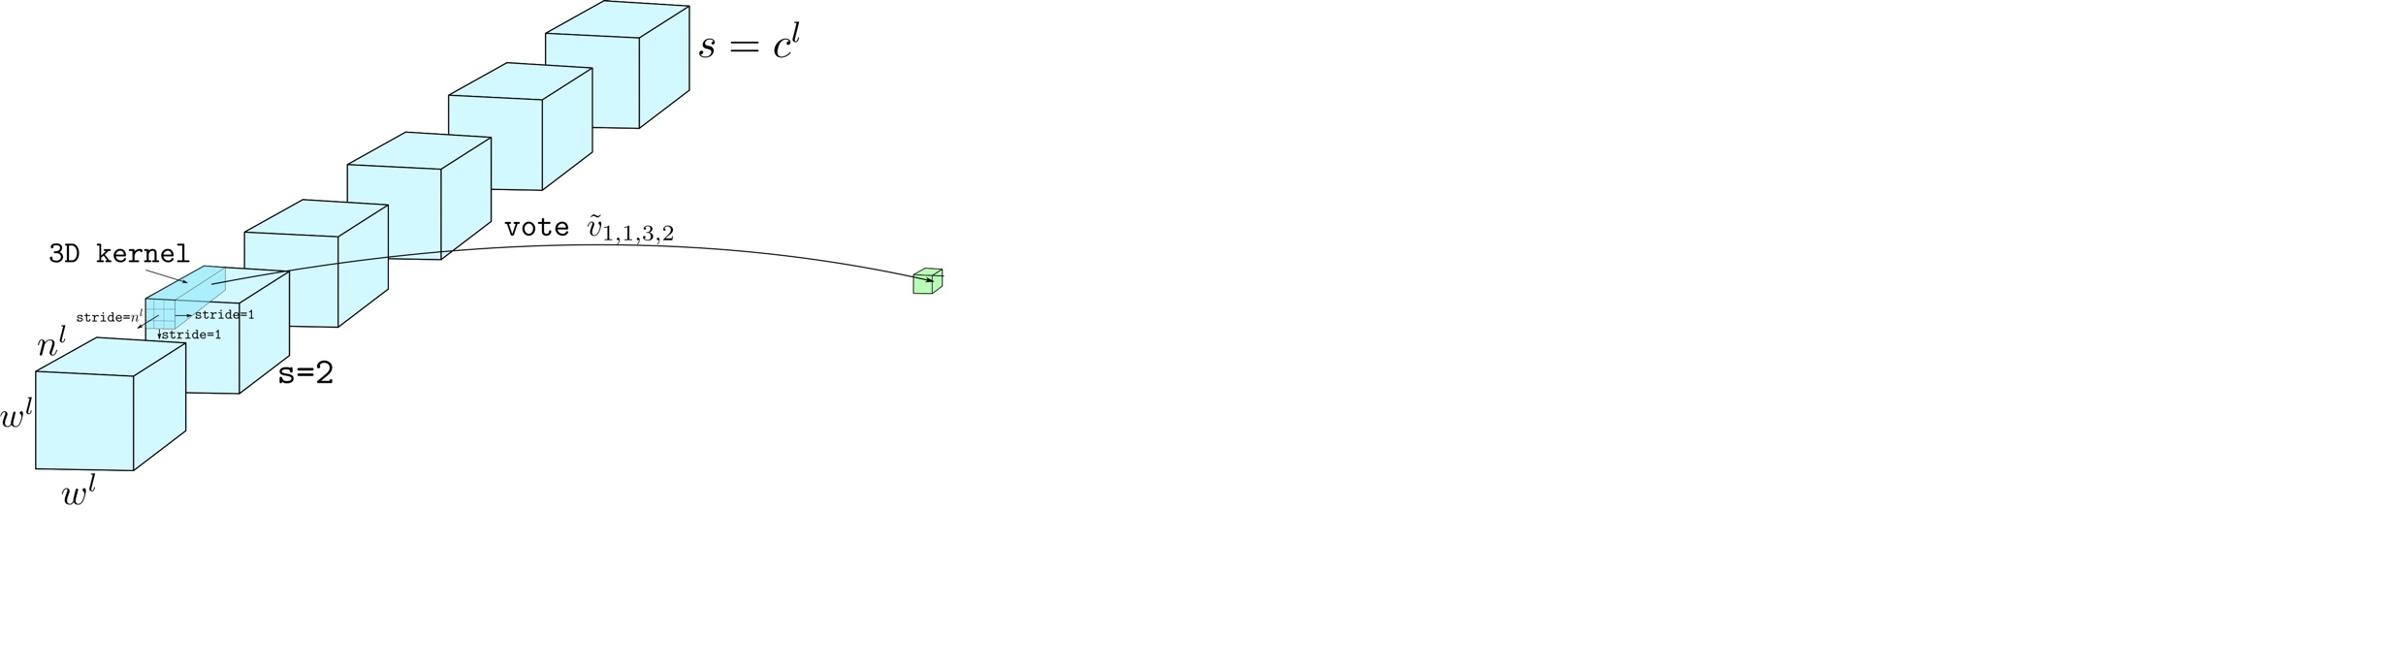
ConvCaps layer
Notes:
Further, a new set of kernels will be used to generate another set of capsules for the next level.
Thus, by applying dynamic routing on these capsule blocks, rather than for each capsules, we achieve computational efficiency in the ConvCaps layer.

Slide 17
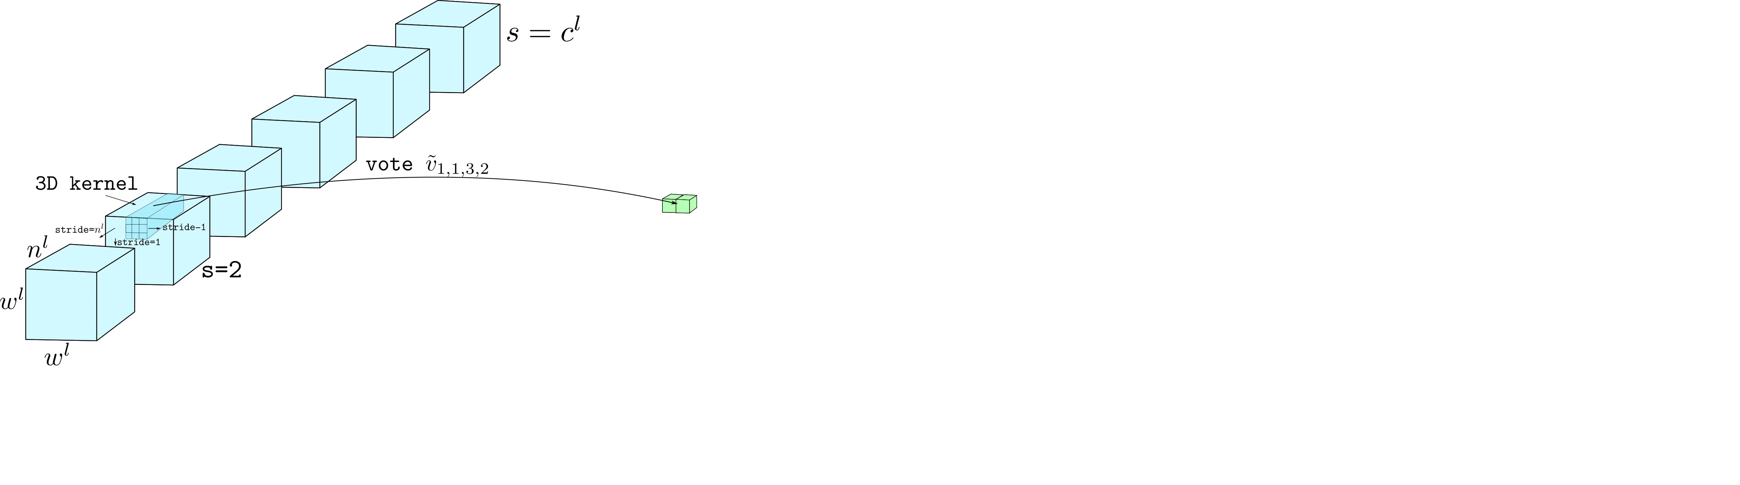
ConvCaps layer
Notes:
Further, a new set of kernels will be used to generate another set of capsules for the next level.
Thus, by applying dynamic routing on these capsule blocks, rather than for each capsules, we achieve computational efficiency in the ConvCaps layer.

Slide 18
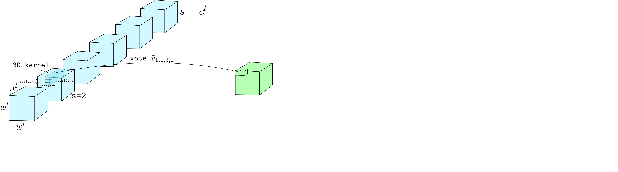
ConvCaps layer
Notes:
Further, a new set of kernels will be used to generate another set of capsules for the next level.
Thus, by applying dynamic routing on these capsule blocks, rather than for each capsules, we achieve computational efficiency in the ConvCaps layer.

Slide 19
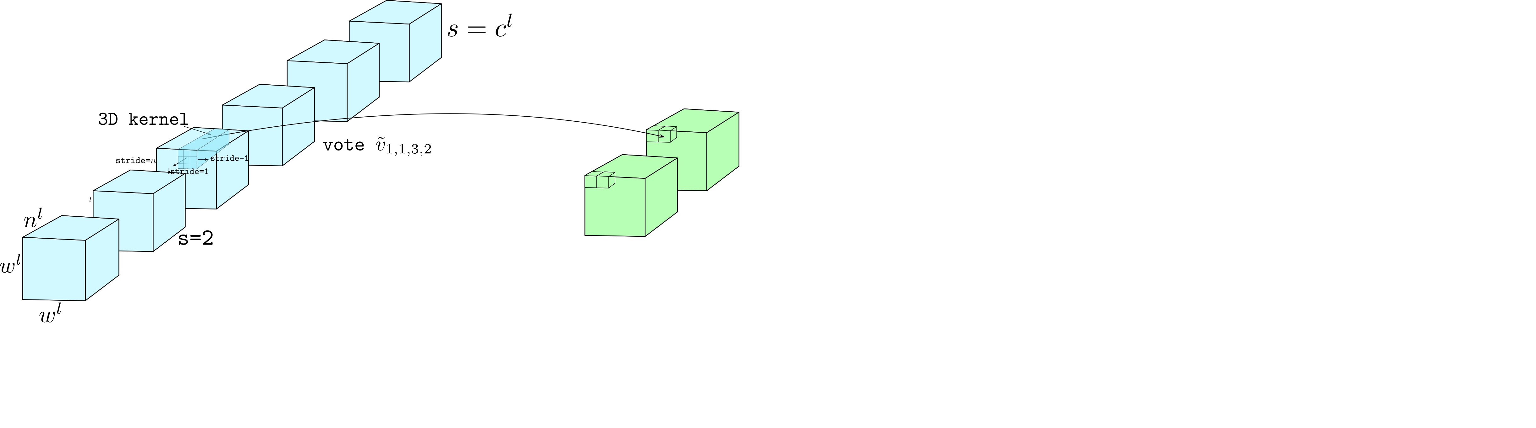
ConvCaps layer
Notes:
Further, a new set of kernels will be used to generate another set of capsules for the next level.
Thus, by applying dynamic routing on these capsule blocks, rather than for each capsules, we achieve computational efficiency in the ConvCaps layer.

Slide 20
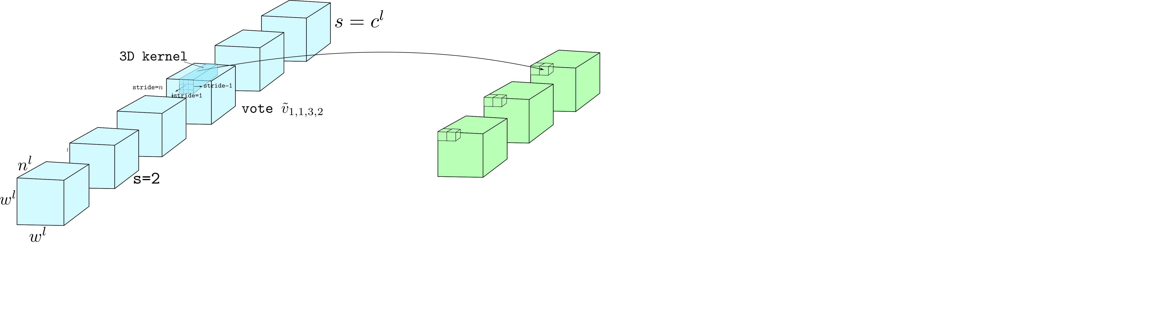
ConvCaps layer
Notes:
Further, a new set of kernels will be used to generate another set of capsules for the next level.
Thus, by applying dynamic routing on these capsule blocks, rather than for each capsules, we achieve computational efficiency in the ConvCaps layer.

Slide 21
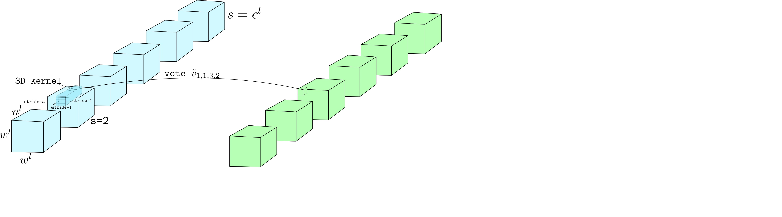
ConvCaps layer
Notes:
Further, a new set of kernels will be used to generate another set of capsules for the next level.
Thus, by applying dynamic routing on these capsule blocks, rather than for each capsules, we achieve computational efficiency in the ConvCaps layer.

Slide 22
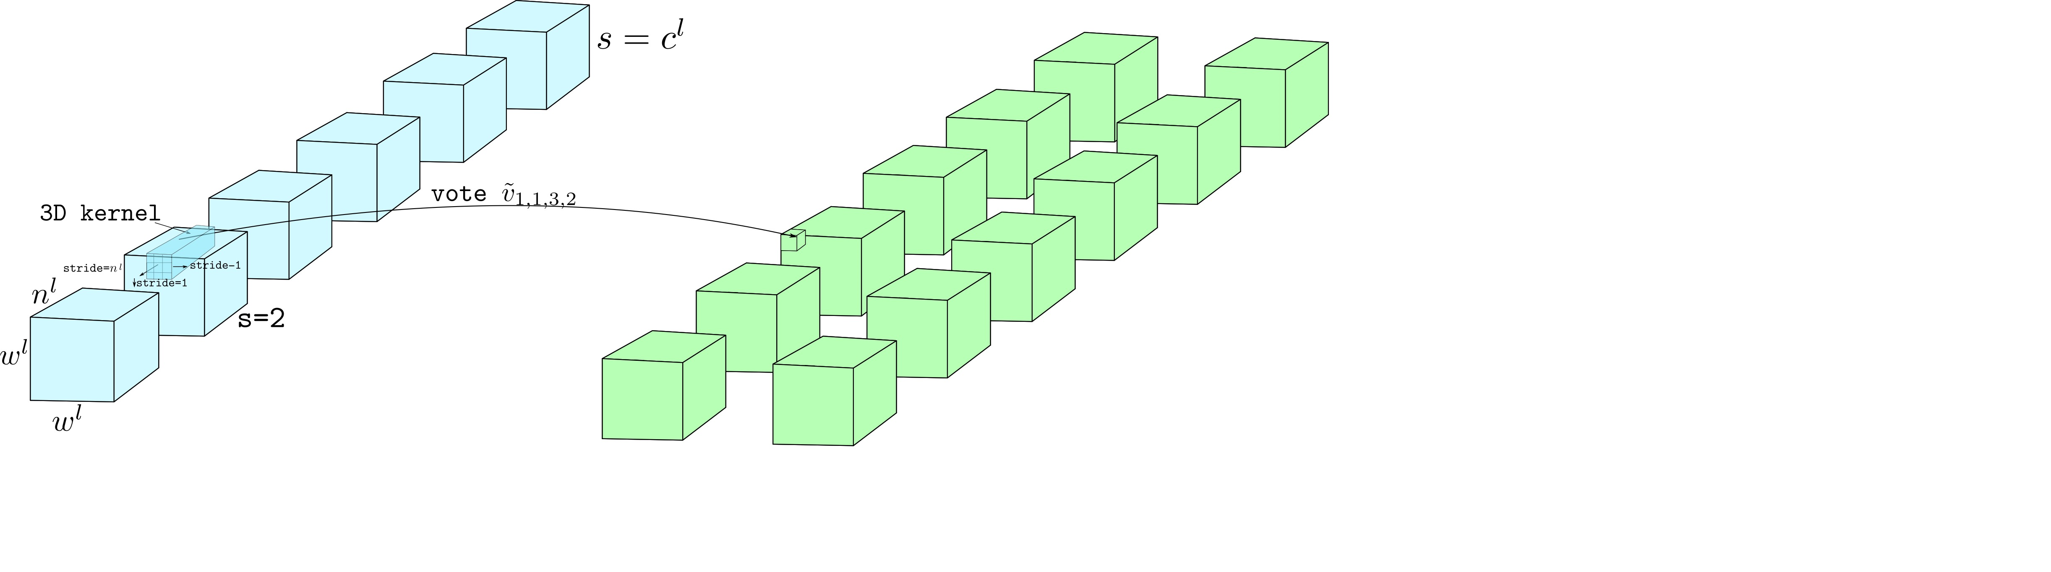
ConvCaps layer
Notes:
Further, a new set of kernels will be used to generate another set of capsules for the next level.
Thus, by applying dynamic routing on these capsule blocks, rather than for each capsules, we achieve computational efficiency in the ConvCaps layer.

Slide 23
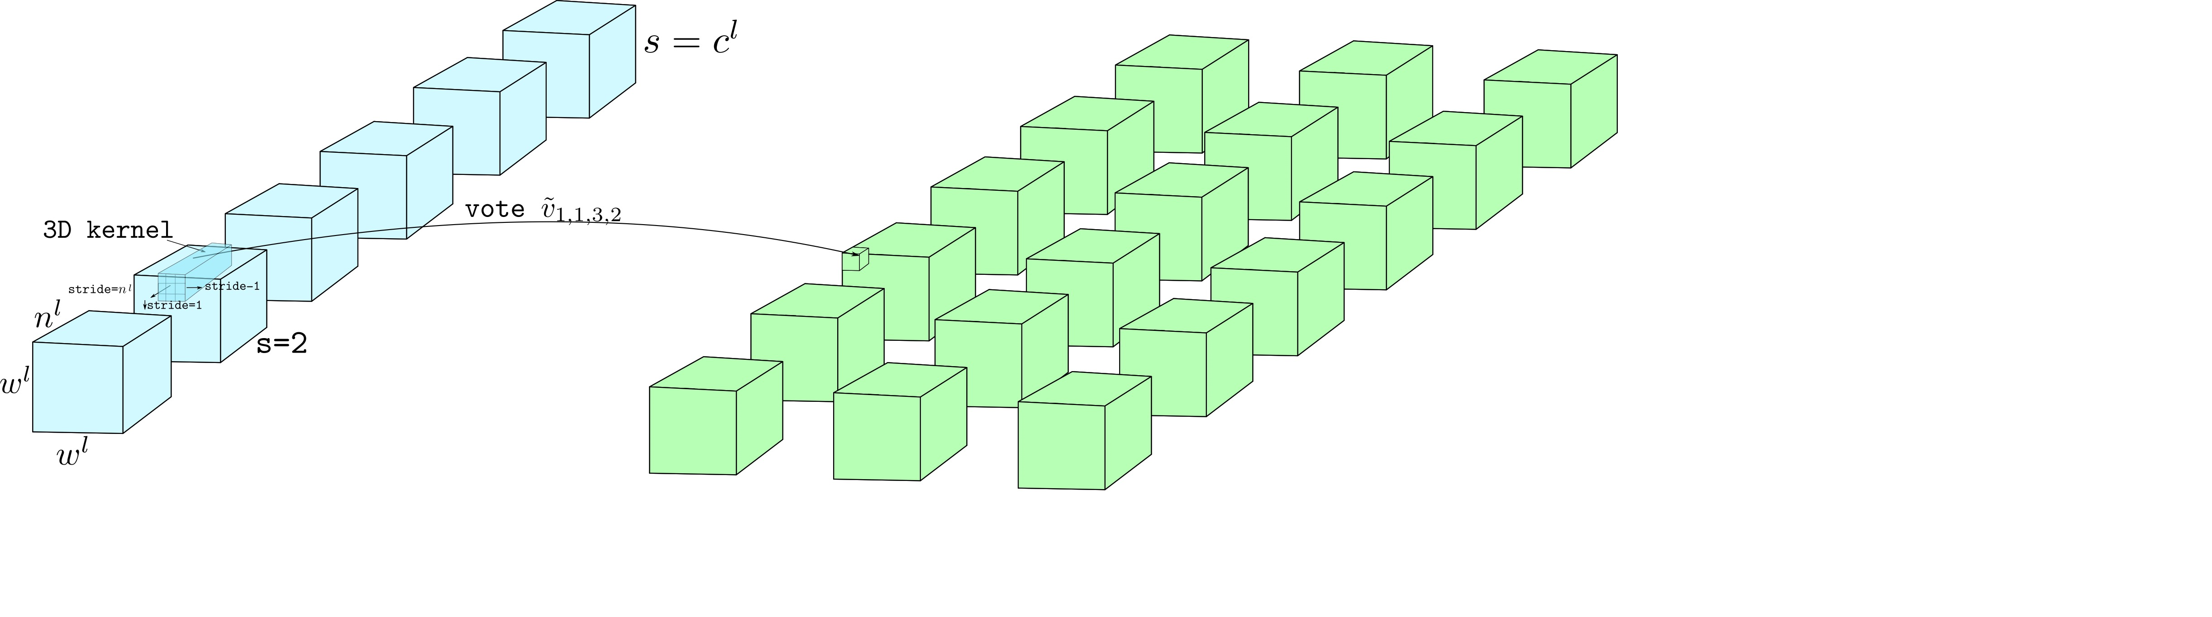
ConvCaps layer
Notes:
Further, a new set of kernels will be used to generate another set of capsules for the next level.
Thus, by applying dynamic routing on these capsule blocks, rather than for each capsules, we achieve computational efficiency in the ConvCaps layer.

Slide 24
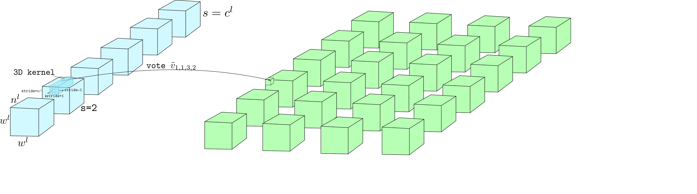
ConvCaps layer
Notes:
Further, a new set of kernels will be used to generate another set of capsules for the next level.
Thus, by applying dynamic routing on these capsule blocks, rather than for each capsules, we achieve computational efficiency in the ConvCaps layer.

Slide 25
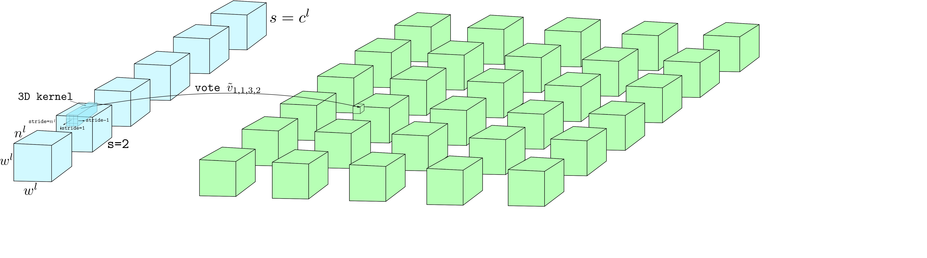
ConvCaps layer
Notes:
Further, a new set of kernels will be used to generate another set of capsules for the next level.
Thus, by applying dynamic routing on these capsule blocks, rather than for each capsules, we achieve computational efficiency in the ConvCaps layer.

Slide 26
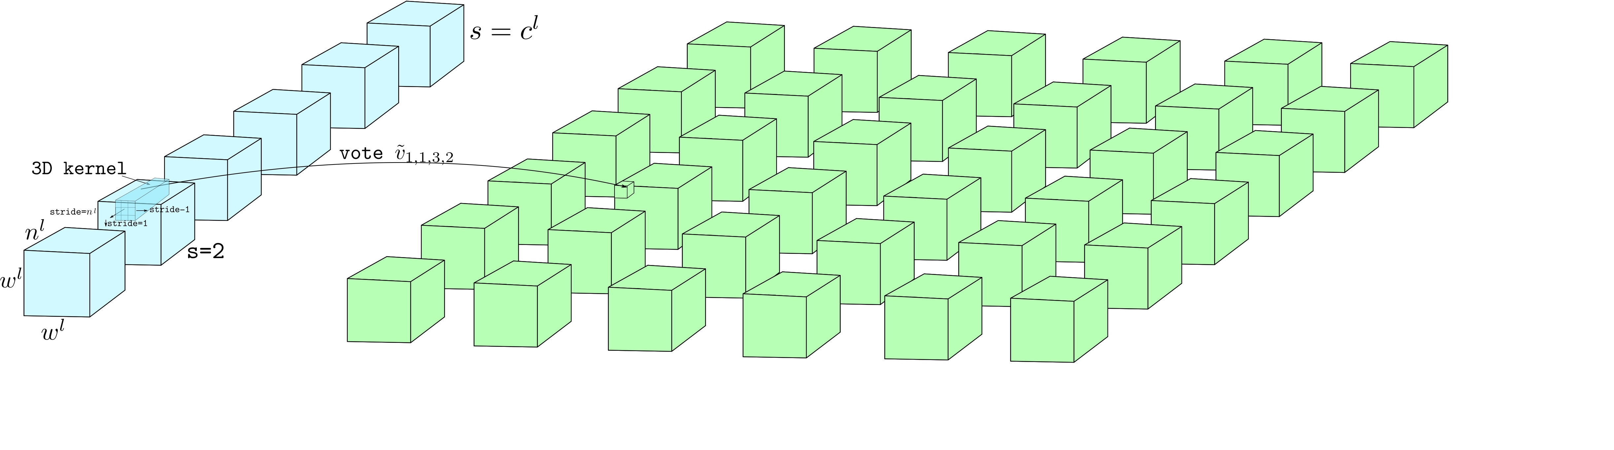
ConvCaps layer
Notes:
Further, a new set of kernels will be used to generate another set of capsules for the next level.
Thus, by applying dynamic routing on these capsule blocks, rather than for each capsules, we achieve computational efficiency in the ConvCaps layer.

Slide 27
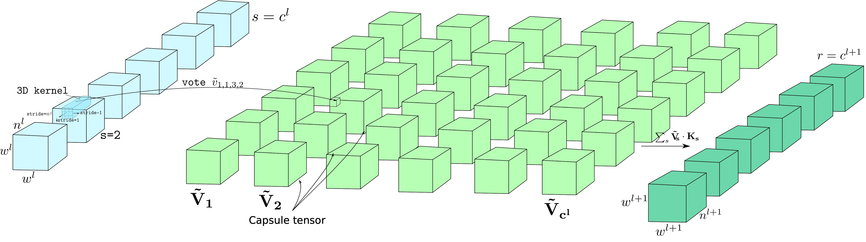
ConvCaps layer
Notes:
Further, a new set of kernels will be used to generate another set of capsules for the next level.
Thus, by applying dynamic routing on these capsule blocks, rather than for each capsules, we achieve computational efficiency in the ConvCaps layer.

Slide 28
Class Independent Decoder
Notes:
The decoder network is used as a regularization to the capsule networks, also as a generator for the instantiation parameters. The capsule networks use a zero-masked instantiation vector as an input to the decoder.
We use a split vector an input for the decoder, this allow us to learn the instantiation parameters as a joint distribution across all the classes.

Slide 29
Results - Error Rates on CIFAR10
Ours
Conventional CNNs
Capsule domain networks
Notes:
Deepcaps achieves the state of the art performance in the domain of capsule networks.
However, it still lags behind the conventional CNN performances.

Slide 30
Results - Performance on other datasets
Model | CIFAR10 | SVHN | F-MNIST | MNIST
DenseNet [1] | 96.40% | 98.41% | 95.40% | -
ResNet [2] | 93.57% | - | - | 99.59%
DPN [3] | 96.35% | - | 95.70% | -
Wan et al. [4] | - | - | - | 99.79%
Zhong et al. [5] | 96.92% | - | 96.35% | -
Sabour et al. [6] | 89.40% | 95.70% | 93.60% | 99.75%
Nair et al. [7] | 67.53% | 91.06 % | 89.80% | 99.50%
HitNet [8] | 73.30% | 94.50% | 92.30% | 99.68%
DeepCaps | 91.01% | 97.16% | 94.46% | 99.72%
DeepCaps (7-ensembles) | 92.74% | 97.56% | 94.73% | -
[1] G. Huang, Z. Liu, L. Van Der Maaten, and K. Q. Wein- berger, “Densely connected convolutional networks.” in CVPR, 2017.
[2] K.He,X.Zhang,S.Ren,andJ.Sun,“Deepresiduallearning for image recognition,” in CVPR , 2016.
[3] Y. Chen, J. Li, H. Xiao, X. Jin, S. Yan, and J. Feng, “Dual path networks,” in NIPS, 2017.
[4] L.Wan,M.Zeiler,S.Zhang,Y.L.Cun,andR.Fergus,“Reg- ularization of neural networks using dropconnect,” ICML , 2013.
[5] Z. Zhong, L. Zheng, G. Kang, S. Li, and Y. Yang, “Random erasing data augmentation,” CoRR, 2017.
[6] S. Sabour, N. Frosst, and G. E. Hinton, “Dynamic routing be- tween capsules,” in NIPS, 2017.
[7] P. Q. Nair, R. Doshi, and S. Keselj, “Pushing the limits of capsule networks,” 2018.
[8] A.Delie`ge,A.Cioppa,andM.VanDroogenbroeck,“Hitnet: a neural network with capsules embedded in a hit-or-miss layer, extended with hybrid data augmentation and ghost capsules,” CoRR, 2018.
Notes:
Deepcaps achieves the state of the art performance in the domain of capsule networks.
However, it still lags behind the conventional CNN performances.

Slide 31
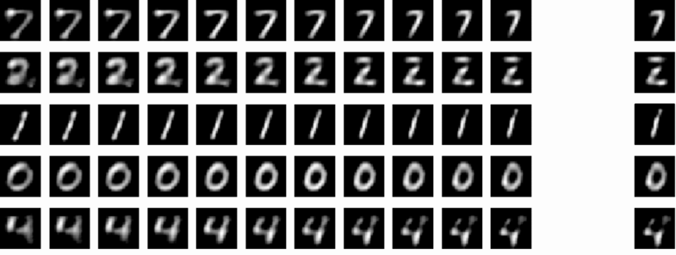
Results - Instantiation parameter perturbation
Notes:
Since the instantiation parameters are learned jointly, for a change in a given instantiation parameter, the decoder will reflect the same effect across all the classes.

Slide 32





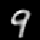
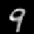
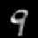
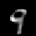
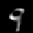
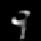


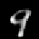
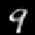
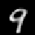














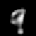





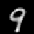


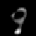
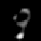
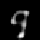

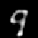
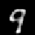
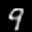

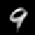



Results
Rotation
(10)
Vertical elongation
(18)
Thickness
(1)
Vertical expansion
(30)
Localized skewness
(6)
Notes:
By jointly learning the instantiation parameters, we can uniquely identify an instantiation parameter and its effect on the reconstructed images.
For example a change in the 10th instantiation parameter will cause rotation in the reconstructed images.

Slide 33
Results
Notes:
Further empirically we found that the instantiation parameter with higher variance will cause global transformations,
while, the rest will be a localized changes.

Slide 34
Thank You!

